Slide 1
Analyses of Customer Service Data
A Review

Slide 2
iVision
Objective :
iVision is a well-known analytics firm. Recently, Nile is an E-commerce company collaborated with iVision, intends to improve their customer service.
iVision help Nile to make better business decisions and improve their services. iVision is engaged to provide Nile access to the analytics dashboard and report i.e., Real time dashboard monitoring.
Resource :
Nile has shared its customer service data with iVision.

Slide 3
iVision
Data Description :
• Id: Unique Customer id
• customer_name: Name of the customer
• sentiment: Sentiment of the customer (Neutral, Positive, Very Positive, Negative, Very Negative)
• csat_score: Customer Satisfaction Score (Scale of 1 to 10, 1 being lowest and 10 being Highest)
• call_timestamp: Date on which the call was made by the customer.
• call_day: Day of the Call (1 represents call was made on 1st of the month, similarly for other numbers)
• reason: Reason why the customer called (Billing Question, Service Outage & Payments)
• city: City to which the customer belongs
• state: State to which the customer belongs
• channel: Mode of communication that customer used (Call-center, Chatbot, Email, Web)
• response_time: How fast the customer request was serviced (SLA level 🡪Above SLA, Below SLA, Within SLA)
• call duration in minutes: Duration of the call
• call_center: Location of the call center where service request was handled.

Slide 4
Project Goals:
Customer Sentiment Analysis: Perform sentiment analysis on customer
interactions. Identify positive, negative, and neutral sentiments expressed by
customers to understand overall satisfaction levels.
Root Cause Analysis: Investigate common customer complaints. Pinpoint
recurring problems to address them proactively and prevent future
escalations.
Service Response Time Analysis: Analyze response times for customer
queries and support requests to assess the efficiency of the customer
service team.
Customer Segmentation: Segment customers based on their demographics,
behavior, and preferences. Understand different customer segments' needs
and pain points to tailor services and communications accordingly.
Trends and Patterns Identification: Identify patterns and trends in customer service data to uncover opportunities for process improvements and innovative service offerings.

Slide 5
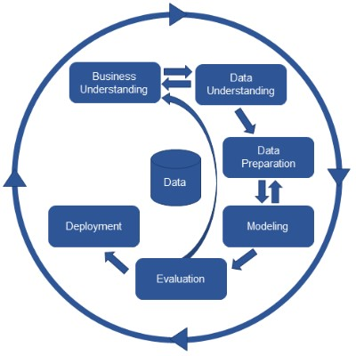
iVision
Business Understanding
Data Understanding
Data Preparation
Modelling
Evaluation
Deployment

Slide 6
iVision
CRISP – DM :
CRISP-DM, which stands for Cross-Industry Standard Process for Data Mining, is an industry-proven way to guide your data mining efforts.
6 CRISP-DM phases :
Business understanding.
Data understanding.
Data preparation.
Modeling.
Evaluation.
Deployment.
Benefits of CRISP-DM :
The CRISP-DM methodology provides a structured approach to data mining, from initial business understanding to final deployment. By breaking down the data mining process into specific phases, CRISP-DM helps organizations to manage the complexity of their projects and improve their chances of success.

Slide 7
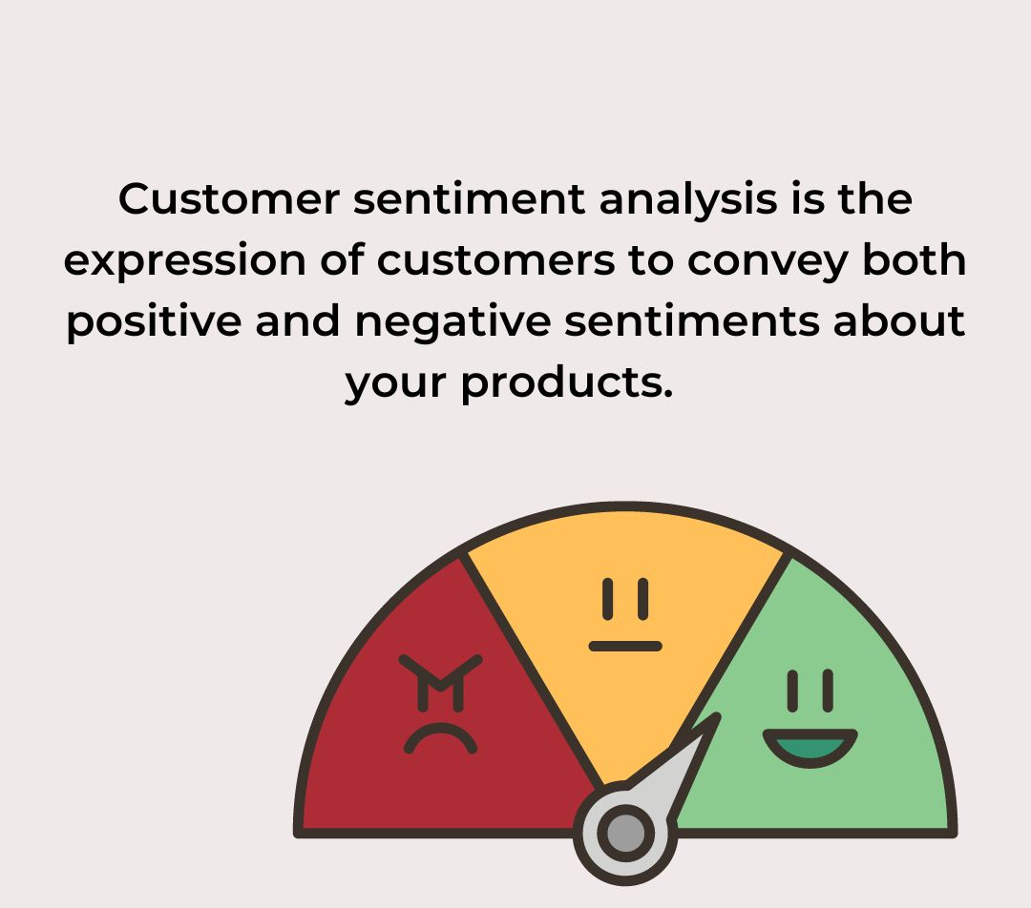
Customer Sentiment Analysis
Customer sentiment analysis : It’s the process of using automated tools to understand and sort customer feedback.
** Points : Customer sentiment is a metric that businesses use to measure how their customers think and feel about their brand.
Objectives : Sentiment analysis is an important way for organizations to understand how customers perceive and experience their products and brands.
For example: “I really like the new design of your website!” → Positive.

Slide 8
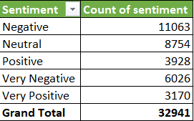
Customer Sentiment Analysis
A
Customer Sentiment
hits under which call Centre in terms of reason
B
overall Customer Sentiment
Notes:
This is a overall Customer Sentiment Analysis and here we got how much positive, negative, and neutral sentiments expressed by
Customers.

Slide 9
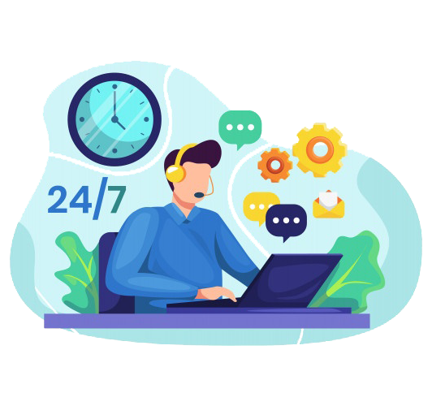
Root Cause Analysis
What is customer complaints : when a business does not deliver on its commitment and does not meet customer expectations in terms of the product or services.
**10 Effective Ways to Reduce Customer Complaints :
1. Improve first call resolution
2. Leverage the latest technology
3. Track complaints using help desk software
4. Do not be rude and show empathy
5. Promise only what you can deliver
6. Deliver omni channel support
7. Offer self-service
8. Optimize your channels
9. Gather customer feedback
10. Improve the internal support operations

Slide 10
Root Cause Analysis
A. This is overall complaints hits under which call centre
B. This is especially present negative and very negative sentiment hits under which call centre and coming through which channel
Notes:
After Investigate we got Billing related complaints are common.

Slide 11
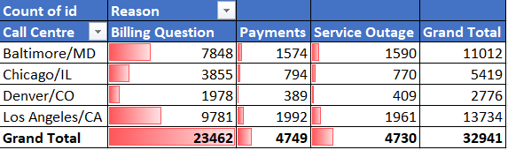
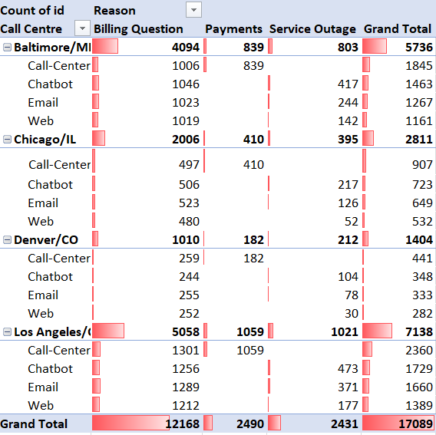
Root Cause Analysis
A. This is overall complaints hits under which call centre
B. This is especially present negative and very negative sentiment hits under which call centre and coming through which channel

Slide 12
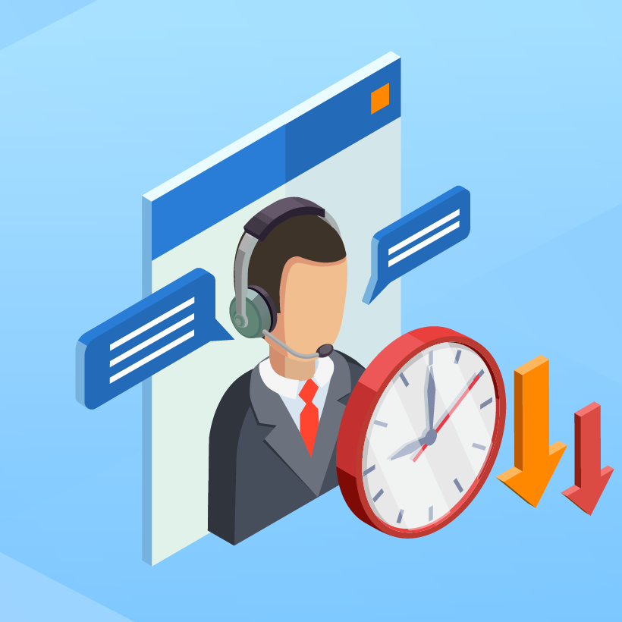
Service Response Time Analysis
What is Service Response Time Analysis : It’s all about Waits, Queues and Time.
How to Improve Your Customer Service Response Time?
1. Set up Automatic Response to Inform Customers They Will Hear Back Soon
2. Expand Canned Responses to Fit a Vast Range of Common Tickets
3. Categorize Tickets Based on Priority
4. Leverage Omnichannel Strategy to Distribute Support Volume
5. Automate Recurring Support Actions to Save Time
6. Reduce Incoming Ticket Volume With Self-service Knowledge Base
7. Utilize Chatbots to Provide 24×7 Support
8. Set Realistic Goals and Track Response Time Effectively

Slide 13
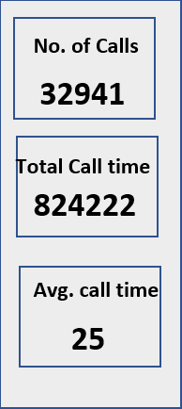
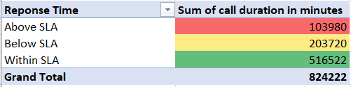
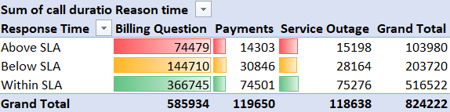
Service Response Time Analysis
This is Overall Report
Total Call duration in minutes

Slide 14
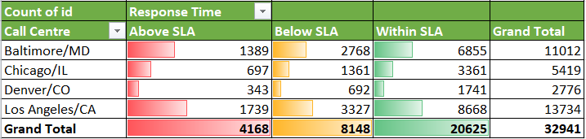
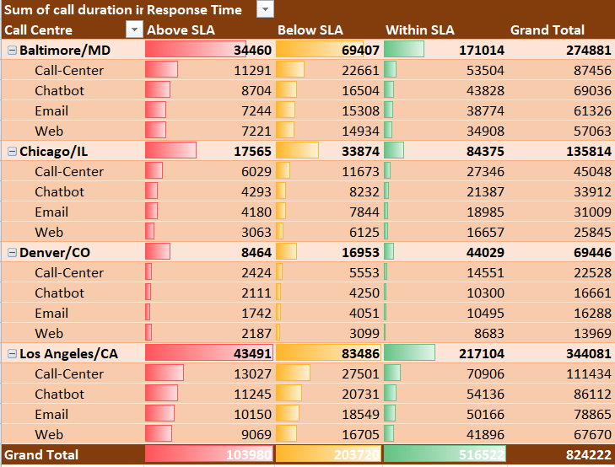
Service Response Time Analysis
This is overall service response time analysis.
Notes:
This is overall service response time analysis.

Slide 15
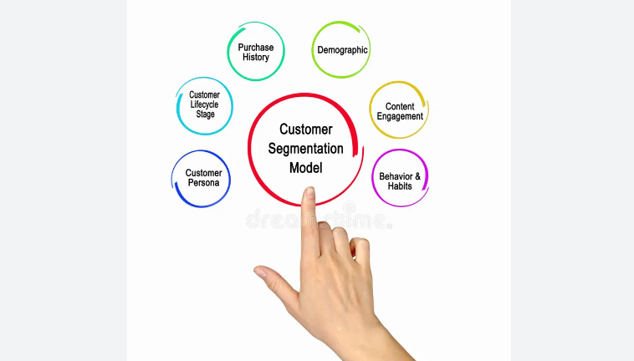
Customer Segmentation
What is Customer segmentation :
Customer segmentation is the practice of dividing a company's customers into groups that reflect similarity among customers in each group. The goal of segmenting customers is to decide how to relate to customers in each segment in order to maximize the value of each customer to the business.
How do you manage customer segmentation?
1. Identify Your Customer Segmentation Goals and Variables.
2. Set Up Each Customer Segmentation Project.
3. Collect and Organize Customer Data.
4. Segment Your Customers Into Groups.
5. Market to Your Customer Segments.

Slide 16
Customer Segmentation
A
B

Slide 17
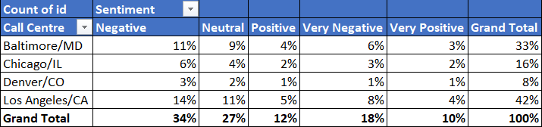
Customer Segmentation
B
A : This is Customer Inquiry Demography and here we can check that how many customers are contacted from which state.
B : Here, we get the total percentage of customer's hit under which call centre and how much customer sentiment hit.

Slide 18
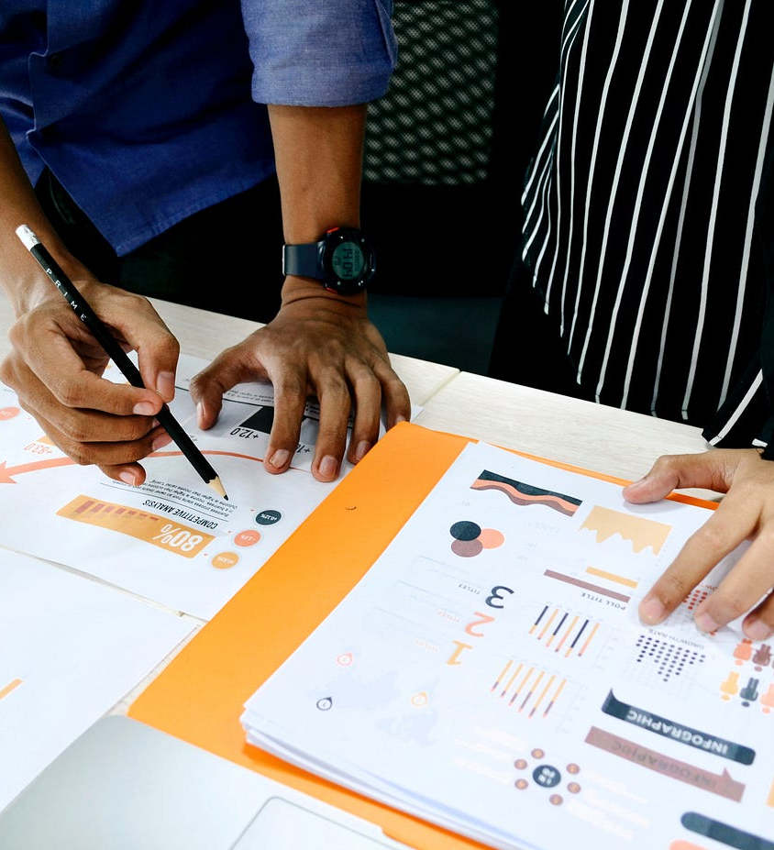
Trends and Patterns Identification
Trends Analysis : Trend analysis is the study of data to identify patterns or trends that can be used to make investment decisions. Trend analysis is a technique used to examine and predict movements of an item based on current and historical data.
Pattern based analysis : The main objective of pattern analysis is to classify the data in a set of predefined groups which is in the form of clusters or classes.

Slide 19
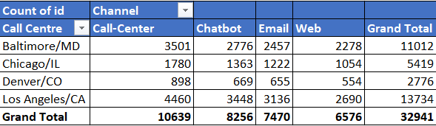
Trends and Patterns Identification
Trends Analysis
This is Call Centre with Channel analysis, where we can see under which call centre through which channel most calls hits.

Slide 20
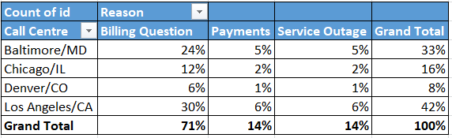
Trends and Patterns Identification
Trends Analysis
This is Call Centre with Reason Analysis, where we can check the total percentage of customer's hit under which call centre and their calling reasons.

Slide 21
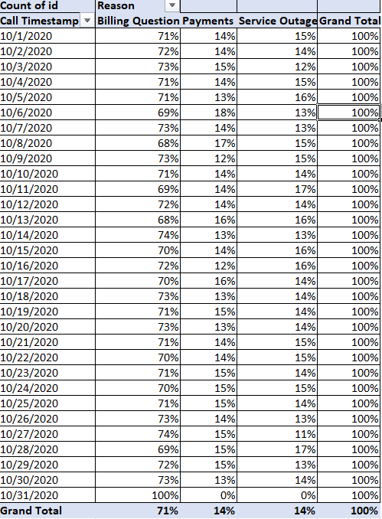
Trends and Patterns Identification
This is Pattern Identification where we can compare the date in each date format & also, we can check the total percentage of the customers calling reason.

Slide 22
Ivision dashboard

Slide 23
Ivision dashboard

Slide 24
iVision
Recommendation : -
Customer Sentiment Analysis: As per observation customer sentiment hits most of the time in Baltimore/MD and Los Angeles/CA. As checked customer called most of the time due to Billing Questions, Payments & Service Outage. So, we must look it very carefully as why these happening everyday and why customer called due to these 3 reasons. Also, billing questions are the most challenging area where customers hit the sentiment. After the analysis we got negative sentiment hits most of the time. So, Nile took care it very sensibly as why customer service agents not fulfilling the customers criteria in terms of billing related queries.
Root Cause Analysis: As per observation there are 3 common complaints Billing Questions, Payments & Service Outage that customer tried to reach out everyday and after all the analysis, we got Billing Questions are the most challenging area. In terms of call center Baltimore/MD, Chicago/IL, Denver/CO and Los Angeles/C, we got Baltimore/MD and Los Angeles/CA took the highest call and hit the customers sentiment. After analysis we also check there are 4 channels that customer tried to reach out everyday and call center deals most of the calls. Nile need to take extra care on call center in terms of others. As, call center is the biggest challenge here as most of the customers tried to reach out everyday. For that reason, customer sentiment hits. Another observation here is Nile need to check the connectivity, network problems, system glitch & any system related issues and improve the quality part. So, if due to network problems or system related issues that customer disconnected the call and gave the negative and very negative feedback so business will go in loss. Also, not because of communication and less information sometimes due to system related issues call got disconnected or cut and customer gave as negative feedback as they don’t know the actual reason. So, during analysis I have created table in 2 parts one is overall reasons under all sentiments, and another is pinpoint only negative and very negative part.

Slide 25
iVision
Service Response Time Analysis: As per observation we got Baltimore/MD and Los Angeles/CA took the highest call & also due to these reason above SLA hits. Also, if we checked in terms of above SLA, within SLA cases also in a good number. So, that means customer agents tried to meet the SLA but somehow due to knowledge gap or system glitch time took longer and for that reason customers sentiment hit.
Customer Segmentation: As per observation California people calls in a highest amount & also if we checked the analysis part, we got Baltimore and Los Angeles took most of the call in terms of others. For that reason, customers sentiment hit & also in response time above SLA hit. Nile need to take more initiative on Baltimore and Los Angeles call center.
Trends and Patterns Identification: As per observation we got under which channel customer called most of the time and what reason. We checked Baltimore/MD and Los Angeles/CA dealt most of the cases everyday, so Nile need to more focus on these part. Also, we have pattern identification where we can compare the date in each format & also, we can check the total percentage of the customers calling reason.

Slide 26
iVision
Conclusion : -
After all the analysis of customer service data, we have all the reports in daily basis. Nile main focus is to decrease call duration in call centre, bring down above sla and also check the complaints part. Nile need to check the connectivity, network problems, system glitch & any system related issues and improve the quality part also. So, if due to system glitch or system related issues happen and for that reason customer call or chat or any other channel may disconnected then they gave us negative and very negative feedback and at the end of day business will suffer. Also, not because of communication and less information sometimes due to system related issues call got disconnected or cut and customer gave as negative feedback as they don’t know the actual reason so Nile need to take extra care on this and look into it. We checked Baltimore/MD and Los Angeles/CA dealt most of the cases everyday in terms of Denver & Chicago, so Nile need to more focus on these Baltimore/MD and Los Angeles/CA call centre. Another observation is in terms of channel call centre dealt most of the cases and customer called most of the time in terms of other channels. Nile need to look into it why customer only called in terms of email or Chabot or web. So, Is there any difficulties or issues to connect for that reason customer more prefer call centre. Another thing is if call centre dealt most of the cases and above sla hit also lots of billing related queries comes up so Nile’s customer agents and quality team need to more focus on it. Nile need to set AHT & target in terms of call duration. Another thing is after every successful call there will be automated sms send to customers phone so that will help to get the feedback from customers end. If knowledge required, regarding the reasons why customer called or tried to reach out for what reason and that time advisors are not ready to answer or not gave the right solution then sentiment will fall down. So, if required refresher training is necessary for those whose call duration is high and get random negative and very negative feedback. Quality audits also necessary. Another thing is placed as many advisors on Baltimore & Los Angeles specially on call centre department so advisor will help each other, communicate and easy to understand. Check every day report & also compare the data every time. Then Nile gets the actual real time data and understand the problems that previously happened by checked with these charts and tables.

Slide 27
Prepared & Presented by
Siddhartha Majumder
ABADS B11
Contact - 7003902099
Email - siddharthamajumder007@gmail.com

